Slide 1
Important ideas
Positive feedback
Returns to scale
  Demand side
  Supply side
Network effects
  Critical mass
SIMS

Slide 2
Positive feedback
How a system adjusts to perturbations
  Negative feedback: stabilizing
  Positive feedback: destabilizing
  Electric blankets
Positive feedback makes a market “tippy”
  Examples: VHS v. Beta, Wintel v. Apple, eBay, AM stereo radio
  “Winner take all markets”
SIMS

Slide 3
Sources of positive feedback
Supply side economies of scale
  Declining unit costs
  Marginal cost less than average cost
  Example: information goods are mostly fixed cost
Demand side economies of scale
  AKA “network effects”
  Increasing value to users as market share increases.
  Expectations are critical
SIMS

Slide 4
Single technology and/or standards wars
A single standard technology
  Fax
  Email
  Web
Competing standards (wars)
  VHS v. Beta,
  Wintel v. Apple
SIMS

Slide 5
Direct and indirect network effects
Value to me depends directly on number of adopters
  Fax machine, telephone, email, IM
Value to me depends on adoption of some complementary product
  DVD player/ DVD disks
  eBook reader + content
  Payment system
  eBay and online auctions
SIMS

Slide 6
Real and virtual networks
Physical networks – as in telecom networks (Picturephone)
Virtual networks – group of users
Metcalfe’s Law: Value of network of size n proportional to n²
Importance of expectations: I want to join network that I expect to succeed. Otherwise, I might be stranded…
STOP FOR DEMO
SIMS

Slide 7
Why care about networks? Lock-in and switching costs
Network effects lead to substantial collective switching costs and lock-in
Even worse than individual switching costs due to coordination costs
Examples: QWERTY, which side of road you drive on, Microsoft Windows, eBay, etc.
SIMS

Slide 8
Network effects and lock-in
Lock-in (individual or collective) is good for firms, since it reduces competition
One may be able to create a network effect where there isn’t a “natural effect”
  Cell phones: “Family and friends”, “calls in same network have reduced rate”
  VOIP: Skype to Skype calls are free
  More examples?
SIMS

Slide 9
Don’t get carried away
Network externalities don’t always apply
  ISPs?
  Dell?
  Cell phones?
  Google search?
  Content production?
Likelihood of tipping
  See next slide
SIMS

Slide 10
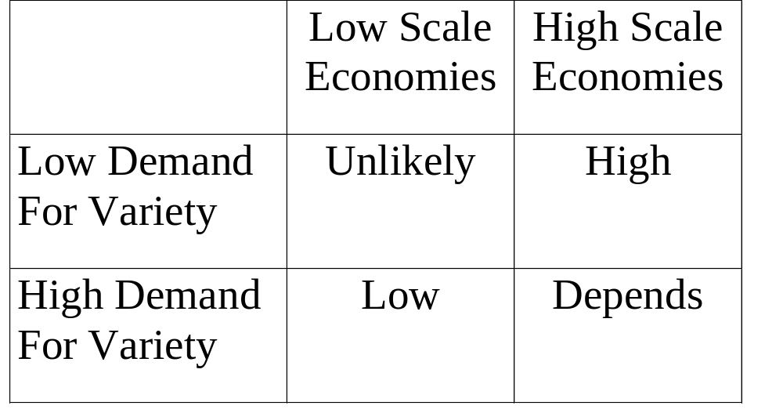
Likelihood of tipping
SIMS

Slide 11
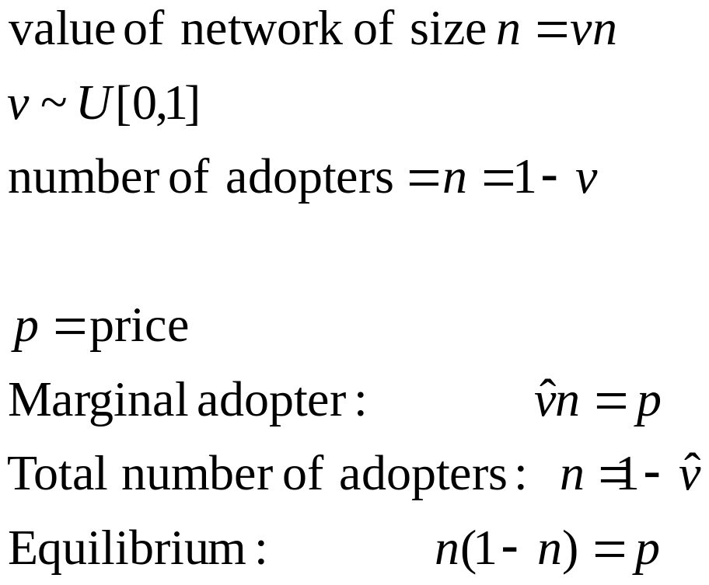
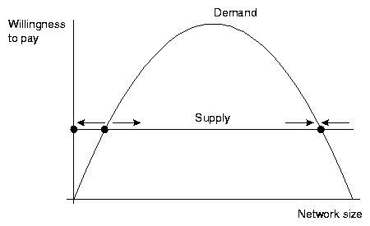
Model of network effects
SIMS

Slide 12
What determines critical mass?
Critical mass = location of unstable equilibrium
Factors
  Pricing level
  How quickly expectations adjust
  Strength of network effect v demand variation
price
Critical
mass
SIMS

Slide 13
Getting to critical mass
Penetration pricing
  DVDs, spreadsheet wars
Manage expectations – those expected to win will win
Extending existing network via strategic bundling
  Microsoft Office and Outlook product introduction
Dominate a submarket then expand - Visa
Acquire high-leverage customers
  PCs, modems and BBS
Offer high level of stand-alone functionality
  VCRs, calendaring functionality
Build an alliance
  Vertical integration and/or agreements (TV with RCA/NBC, Philips/Polygram, VCRs/stores, DVD Forum, Google print)
  But be careful about vertical integration in discouraging entry (Philips eventually sold Polygram)
SIMS

Slide 14
Lessons
Positive feedback means strong get stronger and weak get weaker
  Supply side: cost advantage
  Demand side: value advantage
    Consumer expectations are critical
Works for large networks, against small ones
SIMS

Slide 15
Launching a new network
Picturephone – price too high
Fax and fax machines – early adopters in one vertical
VCRs and tapes – standalone value
DVDs: no standalone value, but high degree of coordination
SIMS

Slide 16
Extending an existing network
Evolution
  Give up some performance to ensure compatibility with existing network, thus easing consumer adoption
Revolution
  Wipe the slate clean and come up with the best product possible
Video industry
  High performance VCR v DVD
  HD-DVD (Warner, Paramount and Universal) v Blu-Ray (Sony)
SIMS

Slide 17
Evolution
Offer a migration path
Examples
  Microsoft Windows
  Intel 8088, Itanium
  Borland v Lotus
Build new network by links to old one
Problems: technical and legal
SIMS

Slide 18
Technical obstacles
Use creative design for migration
Think in terms of whole system
Converters and bridge technologies
  One-way compatibility or two way?
  Windows for Wordperfect users
  Importance of UI for adoption
SIMS

Slide 19
Legal Obstacles
May need IP licensing
Example: Sony and Philips had advantage in DVD technology since they held the patents on CDs
  DVD players usually play CDs as well
SIMS

Slide 20
Revolution
Groves’s law: “10X rule”
But depends on switching costs
Example: Nintendo, Iomega Zip, DVD
SIMS

Slide 21
Openness v. Control
Your reward = Total added to industry x your share
Value added to industry
  Depends on value of product and on size of network
Your share
  Depends on how open technology is
SIMS

Slide 22
Openness
Full openness
  Anybody can make the product
  Problem: no champion
  Unix v BSD v Linux
Alliance
  Only members of alliance can use
  Problem: holding alliance together
  DVD players, China, conflict of interest w media producers from problem of complements
SIMS

Slide 23
Control
Control standard and go it alone
If several try this strategy, may lead to standards wars
SIMS

Slide 24
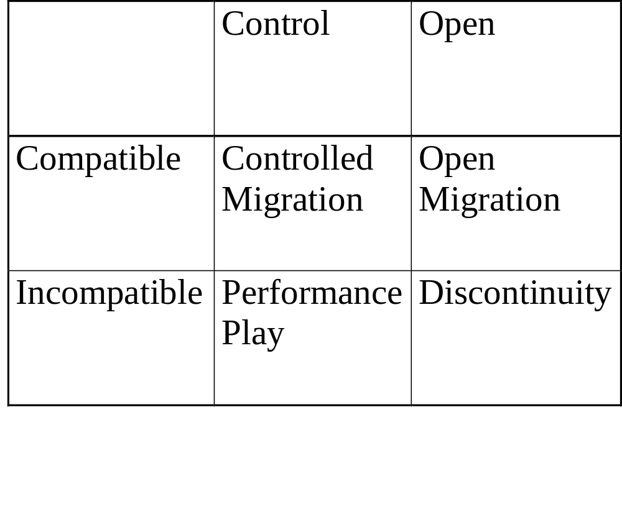
Generic strategies
SIMS

Slide 25
Performance Play
Introduce new, incompatible technology
Examples
  Palm Pilot
  Iomega Zip
  Your examples…
Attractive if
  Great technology
  Outsider with no installed base: nothing to cannibalize
SIMS

Slide 26
Controlled Migration
Compatible, but proprietary
Examples
  Windows 98
  Pentium
  Upgrades to every product
  Your examples…
Some vulnerability to entry since have to pay switching cost anyway
  Your examples…
SIMS

Slide 27
Open Migration
Many vendors, compatible technology
Examples
  Fax machines
  Some modems
  Your examples…
SIMS

Slide 28
Discontinuity
Many vendors, new technology
Examples
  CD audio
  3 1/2” disks
  Your examples…
SIMS

Slide 29
Historical Examples of
Positive Feedback and Interconnection
RR gauges
AC v. DC
Telephone networks
Color TV
HD TV
SIMS

Slide 30
Lessons
Positive feedback means strong get stronger and weak get weaker
Consumers value size of network
Works for large networks, against small ones
Consumer expectations are critical
Fundamental tradeoff: performance and compatibility
SIMS

Slide 31
Lessons, continued
Fundamental tradeoff: openness and control
Generic strategies
  Performance play
  Controlled Migration
  Open Migration
  Discontinuity
Lessons of history
SIMS

